Slide 1

Housing Price Prediction Data
A Machine Learning Approach
EGCO623
Krasion Meekul 6538136
advisor: Asst. Prof. Tanasanee Phienthrakul, Ph.D.

Slide 2


Background:
This project is centered around a dataset that focuses on housing prices. The data has been sourced from a CSV file and includes several key features that are instrumental in determining housing prices.
Objective:
- The main objective of this project is to develop a predictive model that can accurately estimate housing prices based on the features mentioned.
- Evaluate the effectiveness of our predictive model,
we compare its performance against other models developed by Kaggle users.

Slide 3
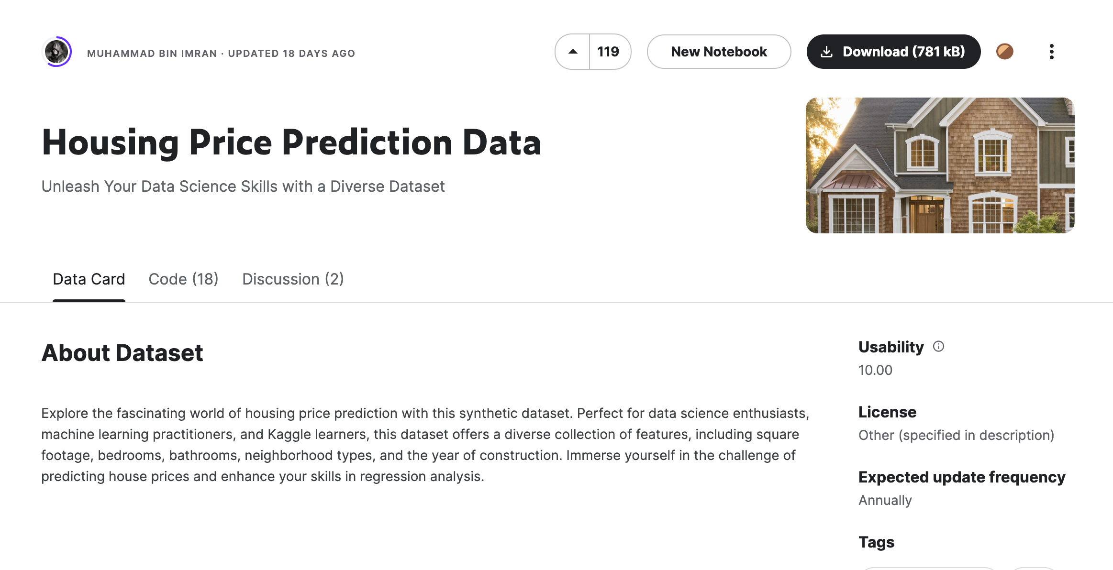
"Housing Price Prediction Data | Kaggle." https://www.kaggle.com/datasets/muhammadbinimran/housing-price-prediction-data.

Slide 4
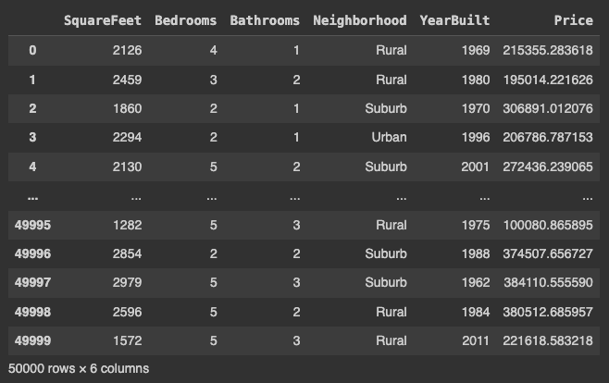
Understanding Dataset.
The housing price dataset is composed of 50,000 entries, each representing individual properties with various attributes. The dataset includes the following columns:
SquareFeet: Indicating the total area of the house in square feet.
Bedrooms: Showing the number of bedrooms in the house.
Bathrooms: Representing the number of bathrooms in the house.
Neighborhood: Specifying the area where the house is located, with values like 'Rural', 'Suburb', and 'Urban'.
YearBuilt: Denoting the year the house was built.
Price: The buying price of the house, which is the target variable for our predictive model.

Slide 5
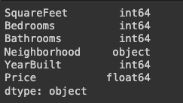
Data Types Verification Prior to Model Training.
*while the Neighborhood feature may require encoding to numerical values

Slide 6
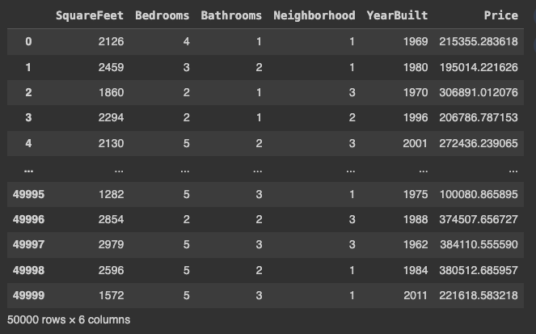
Data Type Transformation for 'Neighborhood' Feature.
'Rural': Assigned a value of 1 to represent rural neighborhoods.
'Urban': Assigned a value of 2 to signify urban neighborhoods.
'Suburb': Assigned a value of 3 to denote suburban neighborhoods.

Slide 7
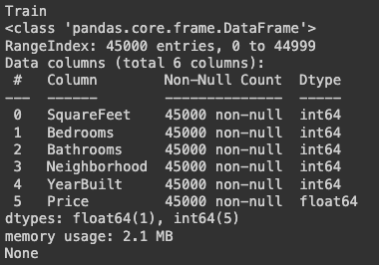
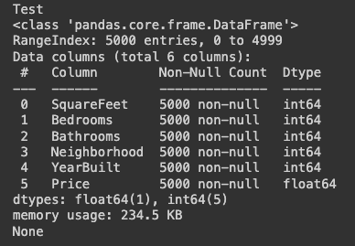
Exploratory Data Analysis.
Data Splitting:
test_size: 0.1
Random_state: 42
Test
Train

Slide 8
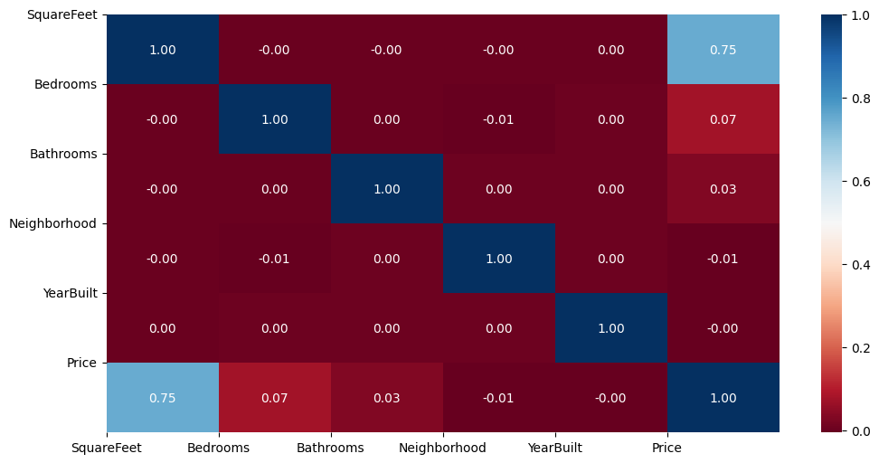
Analysis of Feature Correlations.
SquareFeet and Price: There is a moderate positive correlation (0.75) between the size of the house (in square feet) and its price. This suggests that as the area of the house increases, the price is likely to increase as well, which aligns with market expectations.

Slide 9
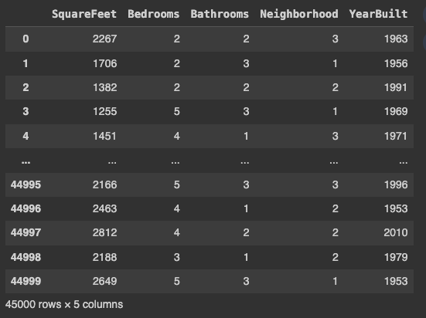

Preparation for machine learning.
Test
Train

Slide 10
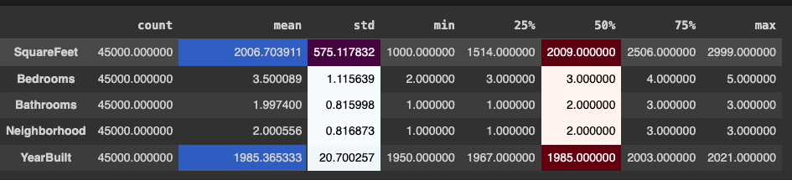
Use method describe.

Slide 11
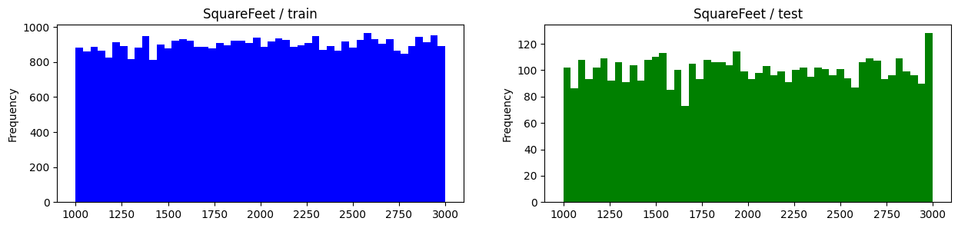
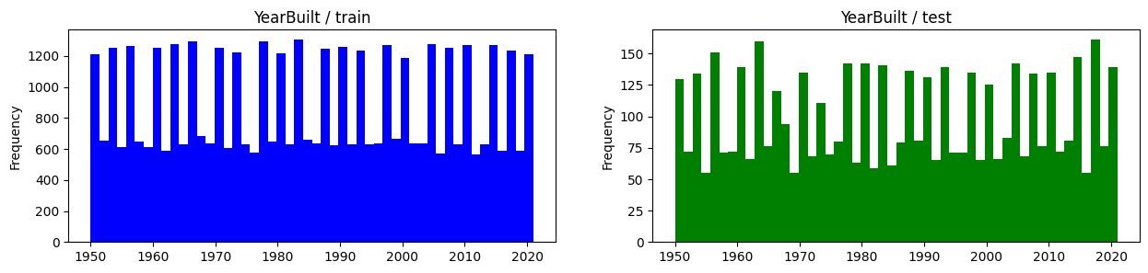
Shows the distribution of data in the train and test datasets in a histogram.

Slide 12
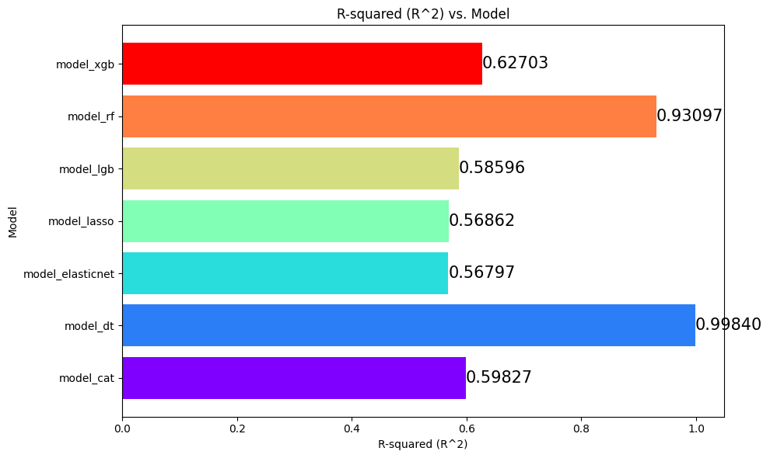
Train Machine Learning Models.
model_cat (CatBoost)
model_dt (Decision Tree)
model_elasticnet (ElasticNet)
model_lasso (Lasso regression)
model_lgb (LightGBM)
model_rf (Random Forest)
model_xgb (XGBoost)

Slide 13
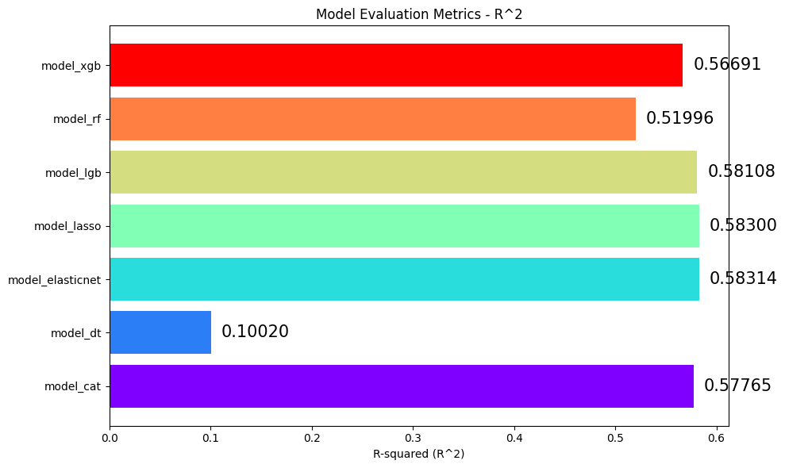
Test Machine Learning Models.

Slide 14
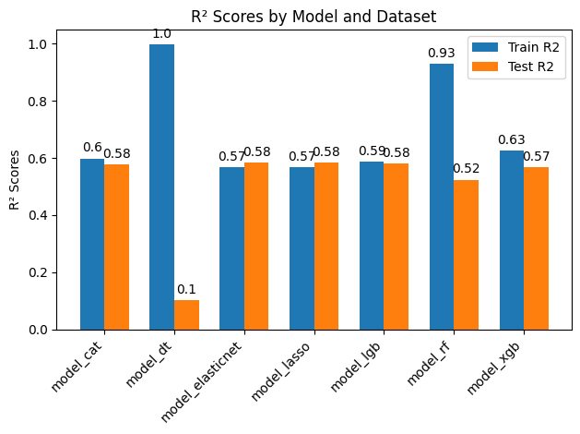
Compare between trends and tests.
CatBoost (model_cat): 3.44% less on test data, indicating minimal overfitting.
Decision Tree (model_dt): Approximately 89.96% less on test data, a strong sign of overfitting.
ElasticNet (model_elasticnet): Test data performs 2.67% better, showing no overfitting and slightly better generalization.
Lasso Regression (model_lasso): Test data performs 2.53% better, indicating no overfitting and slightly better generalization.
LightGBM (model_lgb): 0.83% less on test data, suggesting minimal overfitting.
Random Forest (model_rf): 44.15% less on test data, suggesting moderate overfitting.
XGBoost (model_xgb): 9.59% less on test data, a moderate amount of overfitting.

Slide 15
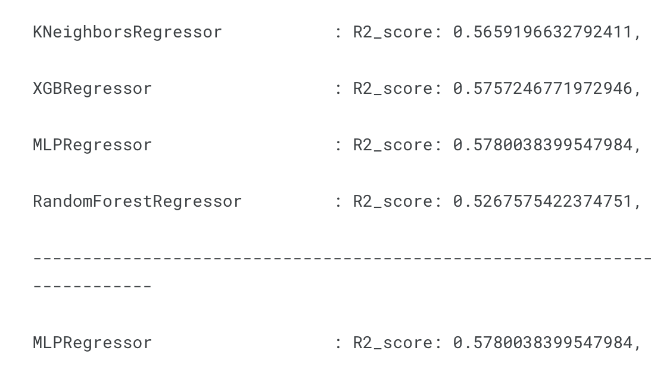
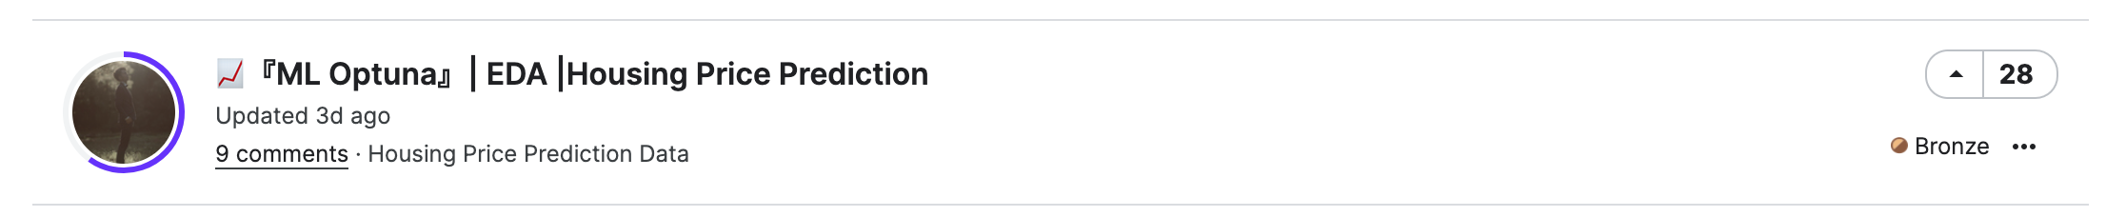
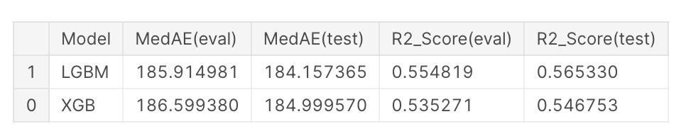
Compare accuracy with other developers.
"『ML Optuna』| EDA |Housing Price Prediction | Kaggle." https://www.kaggle.com/code/guanlintao/ml-optuna-eda-housing-price-prediction.
Model by K1RSN7
Model by Guan Lin Tao
" [EN] Housing Price Prediction Data| Kaggle." https://www.kaggle.com/code/k1rsn7/en-housing- price-prediction-data

Slide 16
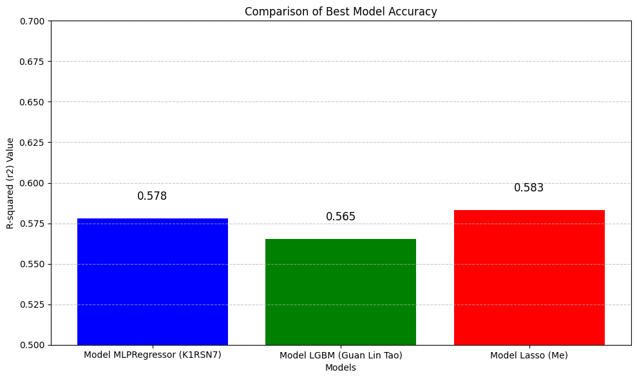
Result Comparison of Best Model Accuracy.

Slide 17

Exchange ideas

